Slide 1

Escheatment
&
Month End Checklists

Slide 2
Topics:
Escheatment – what is it and how does it affect my agency.
Month End Checklists.

Slide 3
Escheatment – what is it?
By definition, escheatment is the process of turning over unclaimed or abandoned property (outstanding checks) to a state authority.

Slide 4
What does this mean for State of Kansas agencies?
All State of Kansas outstanding checks (including SMART checks, Payroll checks and KDOR refund checks), unless specifically exempted by statute or system limitation, shall be escheated (turned over to the Unclaimed Property Division of the Kansas State Treasurer) after 13 months.

Slide 5
  How is this different than in the past?
  In the past, outstanding checks (formerly known as warrants) were outlawed and canceled after 13 months. As noted in Info Circ 14-A-005, effective July 1, 2013, House Bill 2139 of the 2013 legislative session abolished the canceled warrants payment fund; thereby transferring the responsibility for payment of escheated checks to the Unclaimed Property Division of the Kansas State Treasurer.

Slide 6
Where are we now? What has been escheated?
Check Type Check Issue Dates
KDOR – tax refunds 7/1/2008 – 5/31/2012
SHARP Payroll (includes regents) 7/1/2008 – 5/31/2012
STARS Miscellaneous 7/1/2008 – 6/30/2010
SMART – Accounts Payable Cks 7/1/2010 – 9/30/2010

Slide 7
Job aids have been developed to assist agencies with using queries and reports to identify/review checks that have been escheated. All of these job aids can be found on the SMART Web website > Training > Accounts Payable > AP Reports page.
  Using the KS_AP_PYR_EXT_ESCHEATED_CHK Query (to identify payroll checks)
  Using the KS_AP_STARS_EXT_ESCHEATED_CHK Query (to identify STARS Misc. checks)
  Using the KS_AP_KDOR_EXT_ESCHEATED_CHK Query (for use by KDOR)
  Using the KS_ACCT_REGISTER_ESCHEATMENT Report - 11-18-13
  Using the KS_AP_ESCHEATED_CHECKS-Job Aid 7-23-14

Slide 8
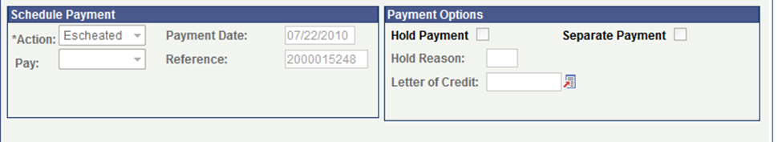

What does a SMART check look like on the voucher if it has been escheated?
On the Payments tab of the Voucher, the Schedule Payment section will have an Action of Escheated.

Slide 9
What is the escheatment schedule going forward?
Check issue dates Escheatment Process Date
July 1, 2010 – September 30, 2010 July 21,2014 - COMPLETED
October 1, 2010 – December 31, 2010 August 13, 2014
January 1, 2011 – June 30, 2011 August 20, 2014
July 1, 2011 – June 30, 2012 September 24, 2014
July 1, 2012 – June 30, 2013 October 22, 2014
July 1, 2013 – September 30, 2013 November 15, 2014
October 1, 2013 – October 31, 2013 December 15, 2014 *
* Monthly pattern thereafter will be to escheat on the 15th of the month or the first business day after
As noted, Payroll and KDOR checks have been escheated through May 31, 2012 – the schedule for these checks is slightly different. OSM is, however, working with Payroll and KDOR staff in an effort to have the monthly escheatment schedule beginning December 15, 2014 coincide between the Payroll and KDOR checks and the SMART checks.

Slide 10
What can agencies do to be ready for escheatment?
All agencies are expected to review outstanding checks and take the necessary action prior to the date scheduled for escheatment.
Job aids have been developed to assist agencies with using queries and reports to identify outstanding checks. All of these job aids can be found on the SMART Web website > Training > Accounts Payable > AP Reports page.
Using the KS_AP_PYR_EXT_CHK_TO_ESCHEAT Query (to identify Payroll checks)
Using the KS_AP_KDOR_EXT_CHK_TO_ESCHEAT Query (for use by KDOR)
Using the KS_AP_OUTSTANDING_CHECKS Query
Using the KS_ACCT_REGISTER Report
Using the KS_AP_OUTSTANDING_TRAVEL-Job Aid 7-22-14 (to identify travel and expense checks)

Slide 11
Agencies generally have three options for handling an outstanding check:
Do nothing – if it has been determined the payment is due to the vendor/employee and the payment remains outstanding, the check will be escheated and transferred to unclaimed property
Cancel – if it has been determined the payment is not due to the vendor/employee, the agency is responsible for canceling the payment
Reissue – if it has been determined the payment was lost, the agency may request the payment be reissued

Slide 12
Exceptions – The follow types of checks will not be escheated:
travel and expense checks
checks from funds exempted from escheatment by statute (only 6 agencies have these funds)
Agencies have two options for handling these outstanding checks:
Cancel – if it has been determined the payment is not due to the vendor/employee, the agency is responsible for initiating the cancellation of the payment
Reissue – if it has been determined the payment was lost, the agency may request the payment be reissued
The appropriate action needs to be taken prior to the scheduled escheatment date, based on the check issue date.

Slide 13



For checks that have been escheated…..
Payees/claimants are able to search for unclaimed property at www.kansasstatetreasurer.com
Enter last name & first name to search or select the Unclaimed Property link to find more information.

Slide 14
Agencies should be aware…..
If a payee/claimant has identified unclaimed property, your agency may receive a call asking for more details about the check.

Slide 15
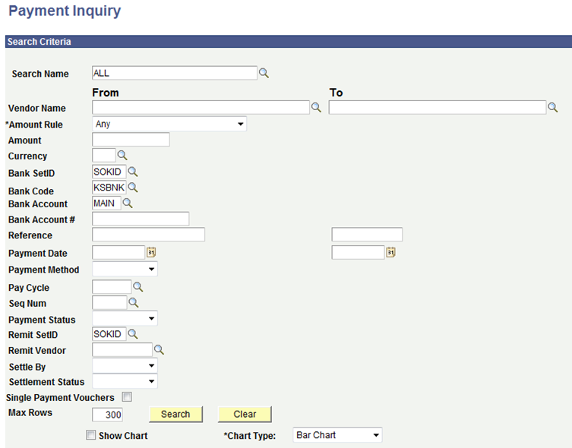

If you receive a call from a payee/claimant and the only information they can provide to you is check number – provided the check is a SMART check, go to Accounts Payable > Review Accounts Payable Info > Payment to get to the Payment Inquiry page.
Use the magnifying glass to select the correct values
Bank Code = KSBNK
Bank Account = MAIN
Enter 10 digit check number in Reference field, then click Search

Slide 16
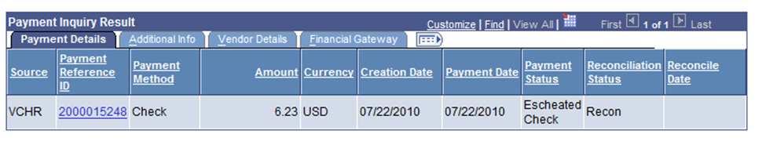


Payment Status will confirm the check has been escheated. By selecting the Payment Reference ID link you will find the Voucher ID to further research any question the claimant has regarding the payment.

Slide 17
Checks dated January 1, 1996 through June 30, 2008
See PM 11,965 – Payment of Previously Outlawed Warrants for more detail.
If the agency is presented with a check dated between January 1, 1996 and June 30, 2008, agency shall provide Form AR-95 – Escheated Check Claim - Validation Form to claimant.
Claimant shall submit completed form to OSM for validation.
OSM will notify agency and/or claimant of the validity of the claim.
A valid claim will be transferred to unclaimed property.
Claimant shall contact the Unclaimed Property Division (see page 13).
No claims will be accepted for checks dated prior to January 1, 1996.

Slide 18
Links to Escheatment Resources:
Informational Circular 14-A-005 - Claims for Escheated Checks
Policy Manual 11,965 - Payment of Previously Outlawed Warrants
SMART Job Aids SMART Web > Training > Accounts Payable > AP Reports
SMART Info Blasts SMART Web > Announcements > General System News

Slide 19

Questions on escheatment?

Slide 20
Month End Checklists

Slide 21
Thank you for your cooperation as we closed fiscal year 2014!
In an effort to make next year even better, agencies are strongly encouraged to be proactive with cleanup efforts on a monthly basis. Errors and corrections are much easier to resolve when done timely. To assist with that, Month End Checklists have been created.

Slide 22
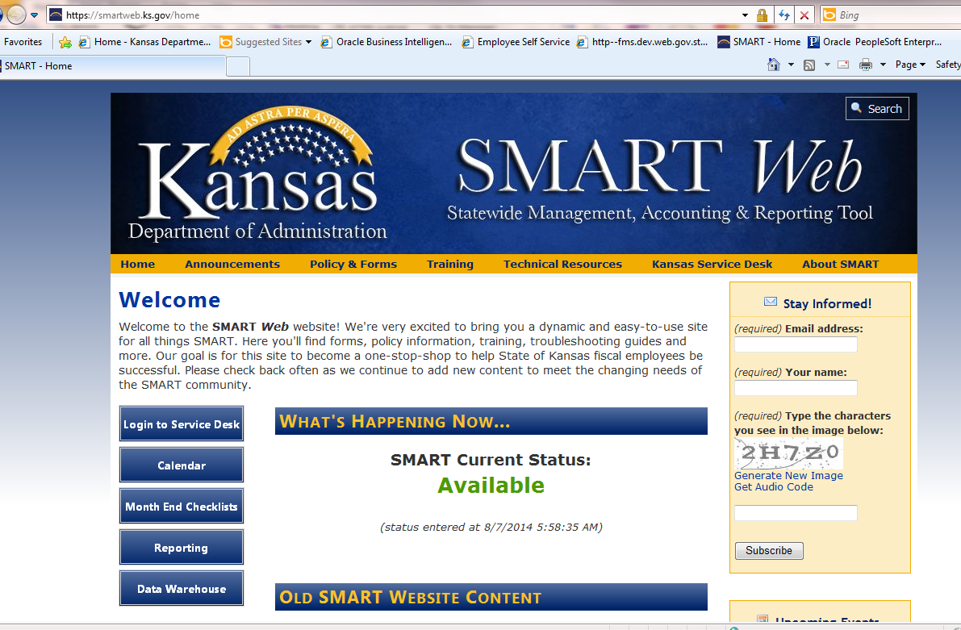
https://smartweb.ks.gov/

Slide 23
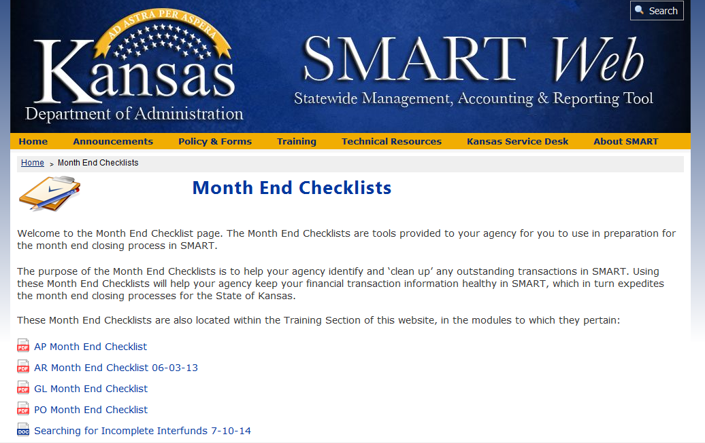
Tools for Travel and Expense are included in the AP Month End Checklist
---New
Each checklist provides instructions and links to job aids for identifying unprocessed or incomplete transactions or transactions in error.
If you have questions as you are working through transactions, enter a Service Desk ticket and a SMART analyst will help you.

Slide 24
We are looking for ideas for the Module of the Month content.
If you have any suggestions for this, please contact the SMART team using the Tell Us What You Think link on the SMART Web site home page.

